Slide 1

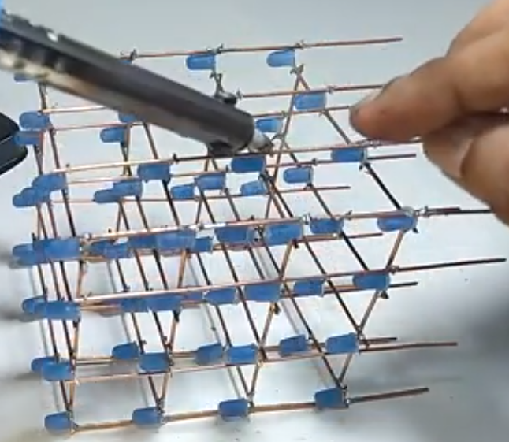
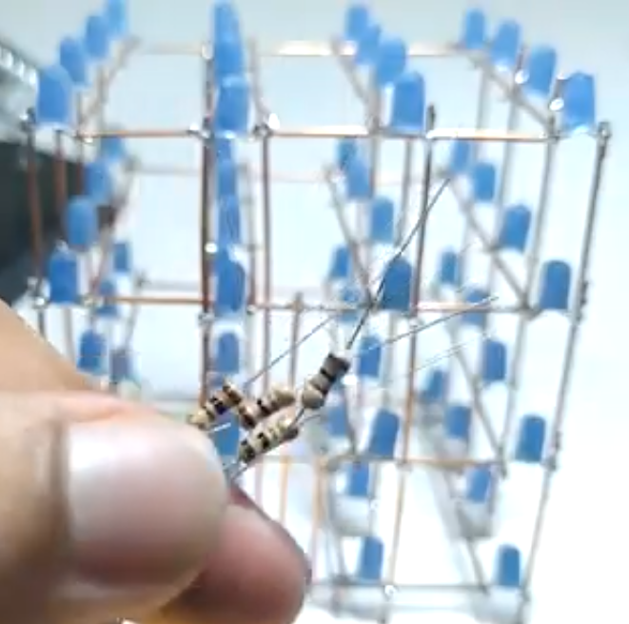
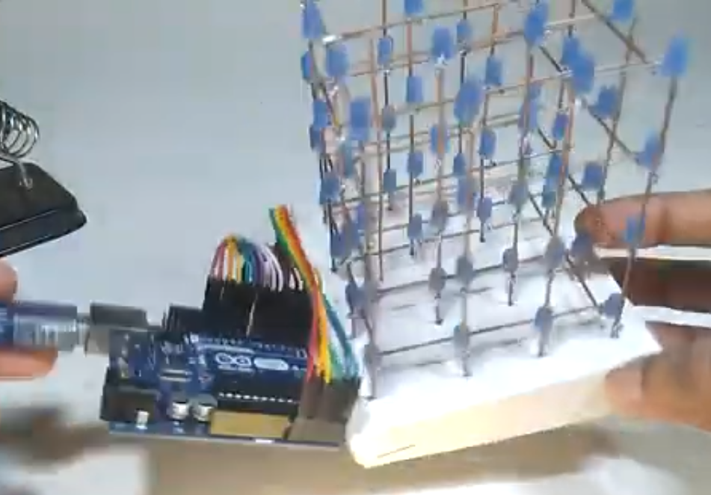

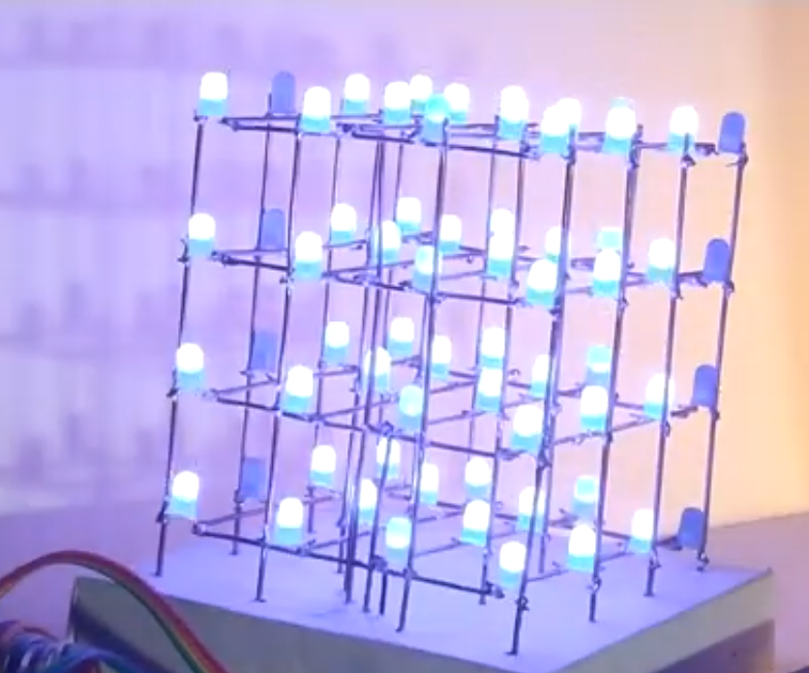
Techscape 2k23 – a journey into the world of iot
4 x 4 x 4 led cube
A 4x4x4 LED cube is a three-dimensional array of 64 LEDs (4 x 4 x 4) that can be individually controlled to create various lighting patterns and effects. It is a popular DIY electronics project that combines programming, circuit design, and basic soldering skills.
MATERIALS REQUIRED :
64 LEDs (preferably of the same color and size)
4 resistors (100-ohm)
A microcontroller (such as Arduino or Raspberry Pi)
A breadboard or a prototyping board
Wires and jumper cables
Soldering iron and solder
1
2
3
Arrange LEDs into 4 x 4 x 4 cube shape &
Solder them together to form cathode & anode layers
Solder 100 - ohm resistor to anode layer & connect anode layer to microcontroller’s output pins .
Cathode layer is connected to microcontroller ‘s ground pin
5
6
Write program to control LEDs using microcontroller.
Test your LED cube and make any necessary adjustments.
SUBMITTED BY :
THOMAS A URK22CO2021
VISHOK S URK22CO2019

